Slide 1
BAIM 3220: Introduction to Python Programming
Navigating Jupyter and Running Our First Python Code
Stephen Taylor
Section 3, Spring 2021

Slide 2
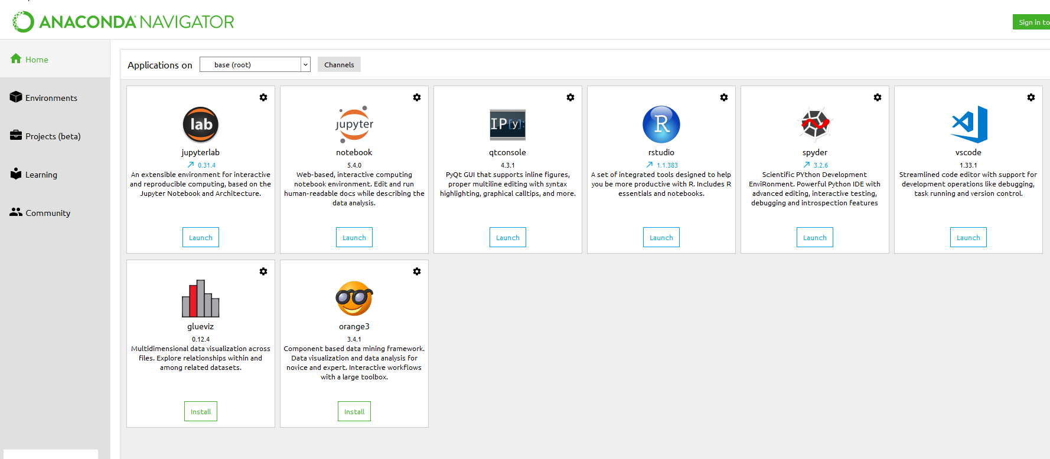
Navigating To Jupyter with Anaconda
Base is the “global” environment. We’ll create “user” environments later.
Open up Anaconda Navigator
Launch Jupyter Notebook

Slide 3
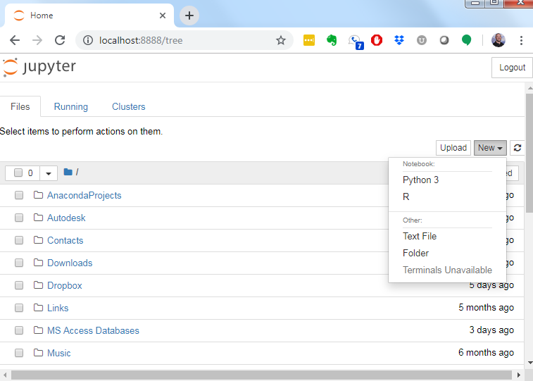
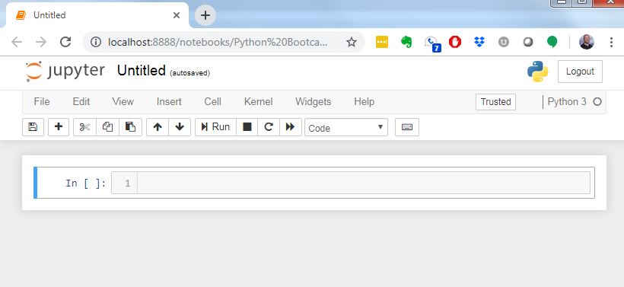
Navigating Jupyter
On Jupyter Main page: Click → File → New Notebook → Python 3
New Python Jupyter Notebook view
Click on the “Untitled” title to change it to W1D1_HelloWorld

Slide 4
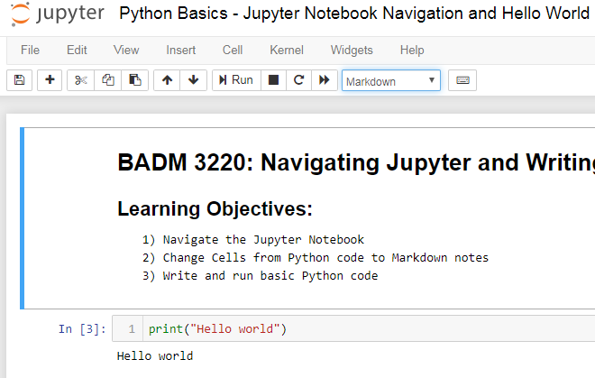
Navigating Jupyter: taking notes
We can switch between writing Python code and taking notes in Jupyter
Select ‘Markdown’ for taking notes ‘Code’ for writing Python

Slide 5
What is Markdown?
“Markdown is a simple syntax that formats text as headers, lists, boldface, and so on.”
Worth a read: https://www.howtogeek.com/448323/what-is-markdown-and-how-do-you-use-it/
It’s used in many places, and especially in the notes section of Notebooks
Absolutely should know headers, links, and lists in MD. Other esoteric uses include tables. We’ll be using Pandas for that later.

Slide 6
Writing our first Python Code in Jupyter
Type the following in the first cell of your notebook
print(“Hello World” )
Run the code in your cell with → Shift + Enter
Your output should display below and a new input cell should be created
Note: keyboard shortcuts such as “Shift + Enter” can be found under:
Help → Keyboard Shortcuts

Slide 7
Next Class...
Using Python to:
Do math stuff
Create variables
Work with different data types
Write your first program
For next class, read chapter 1 in Sweigart (2015)
Download type-along notebooks and watch type-along videos
Complete Quiz 1 on Canvas

